Slide 1
Lecture-2 Social Stratification

Slide 2
Present People
Nationality:
Major ethnic: Bengali
Minor ethnic: Santhals, Chakma, Garos (Achiks), Oraons, Mundas, Mro,Tanchangya,Tripura,Monipuri,Khashia, Kaibarta, Marma, Meitei, Zomi, Bihari(Stranded Pakistani)
They are diversed ethnic communities including Australoid, Tibeto-Burman and Sino-Tibetian races.
Religion:
Muslim 89.5%, Hindu 9.6%, other 0.9% (2004) About 89% of Bangladeshis is Muslims, followed by Hindus (8%), Buddhists (1%) and Christians (0.5%).

Slide 3
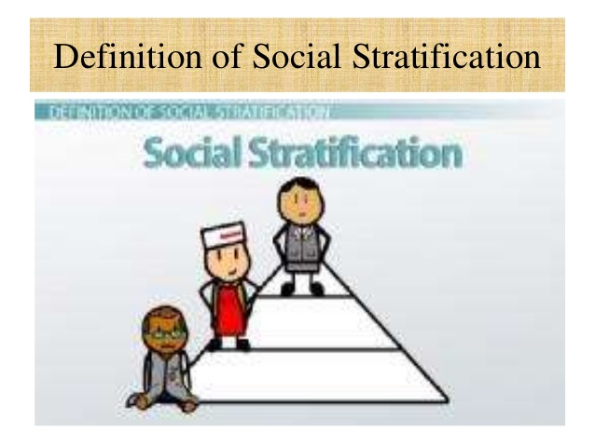
Social Stratification
Definition of Social Stratification
The unequal distribution of goods and services, rights and obligations, power and prestige
Social stratification is structured inequality between groups. This inequality may be based on economics, gender, race, religion, age, or another factor.
A system by which a society ranks categories of people in a hierarchy.
Basis of Social Stratification
Physical appearance, ethnicity, profession, family background, gender, ideology, age or skill in economic/political roles.

Slide 4
Types of Stratification Systems
Estate - Elite owns property and has control over resources.
Caste - Rigid hierarchy of classes.
Class - Status is partially achieved, there is some potential for movement between classes.
Upper class – the elite with great wealth who own the “means of production”, or who otherwise dominate the economic system
Middle class – professionals with high paying jobs in respected occupations (upper-middle class), and the skilled who work in moderately compensated occupations, and who own few assets (lower-middle class).
Lower Class- Lower class people don’t have access in resources, wealth as well as power.

Slide 5
Dimensions of Social Inequality (stratification)
Power—control resources in one’s own interest.
The ability to control the behavior of others, with or without their consent based on force, possession of special skills, knowledge, social status, personal characteristics, and custom/tradition
Wealth—accumulation of material resources or access to production.
Made up of assets (value of everything one owns) and income (money earned through salaries, investments, or capital gains
Prestige—social honor or respect.
Respect, honor, recognition, or courtesy an individual receives from other members of society based on income, occupation, education, family, residences, possessions, club memberships .

Slide 6
Stratification & status
Type of status
Ascribed status - social positions that people hold by virtue of birth
As for example-Race, Sex, Age, Ethnicity, Physical Characteristics, Caste.
Achieved status - social positions attained as a result of individual action e.g.
Occupation, Education, Social class.
Caste System
System of stratification In Hindu society is based on birth. Five caste categories
Brahmins - priests and scholars
Kshatriyas - ruling and warrior caste
Vaisyas - the merchants
Shudras - menial workers and artisans
Harijans – “untouchables”

Slide 7
Among Muslim society we can see two types of social strata-
Ashraf- the people whose ancestors were immigrant Muslims, are called Ashraf and they are treated as more respected.
Atraf- The people whose ancestors were converted Muslims are called Atraf.
Social Stratification in Bangladesh Context
Since the dawn of civilization it is almost a common feature of rural society that it is and was divided into many classes. Rural society in Bangladesh has also its own class formation in terms of
Amount of land
Economic Strength & Occupation
Authority, Coerce & Politics
Religion, Status, Caste etc.
Education, Information and Knowledge

